Slide 1
Text Summarization
Extractive vs. Abstractive Methods Explained

Slide 2
01
Introduction to Text Summarization

Slide 3
Definition and purpose of text summarization
Text summarization is the process of generating short, fluent, and most importantly accurate summary of a respectively longer text document. The main idea behind automatic text summarization is to be able to find a short subset of the most essential information from the entire set and present it in a human-readable format. As online textual data grows, automatic text summarization methods have the potential to be very helpful because more useful information can be read in a short time.
Useful for creating:
• Outlines or abstracts of any document, article, etc .
• Summaries of chat and email
• Action items from a meeting
• Simplifying text by compressing sentences

Slide 4
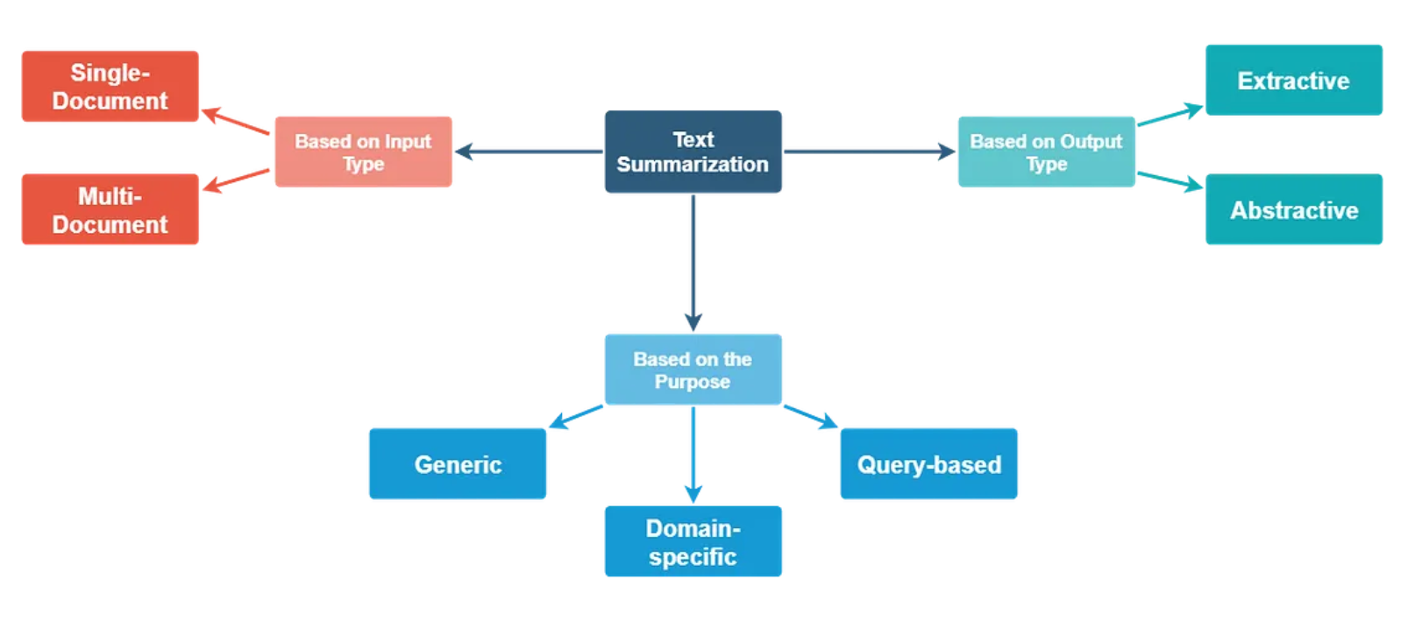
Types of summarization

Slide 5
Extractive and Abstractive summarization
Text summarization can be broadly categorized into extractive and abstractive types. Extractive summarization selects important sentences directly from the source, while abstractive summarization generates new sentences to convey the original meaning more naturally and coherently.

Slide 6
02
Extractive Text Summarization

Slide 7
How extractive summarization works: selecting key sentences
Extractive summarization methods work just like that. It takes the text, ranks all the sentences according to the understanding and relevance of the text, and presents you with the most important sentences.
This method does not create new words or phrases, it just takes the already existing words and phrases and presents only that. You can imagine this as taking a page of text and marking the most important sentences using a highlighter.

Slide 8
Techniques and algorithms used (e.g., frequency-based, graph-based)
Popular extractive techniques include
1.Frequency-Based:-
TF-IDF: Ranks sentences using word importance — higher score for words frequent in a document but rare across others. (Measures how “unique yet important” a word is).
2.Graph-Based:-
TextRank : Represent sentences as nodes and similarity as edges. Compute sentence importance using certain algorithm, which ranks nodes based on how many other important nodes link to them.
Other Methods:
LexRank (graph + cosine similarity),
ML-based (BERTSUM, SummaRuNNer).

Slide 9
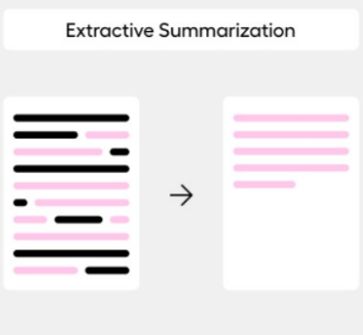
Advantages and limitations of extractive summarization
Extractive summarization offers simplicity and fast processing by reusing exact sentences from the source. It generally maintains grammatical correctness since sentences are unaltered. However, it may result in disjointed summaries and lacks the ability to paraphrase, potentially missing the overall context or nuanced meaning of the original text.

Slide 10
03
Abstractive Text Summarization

Slide 11
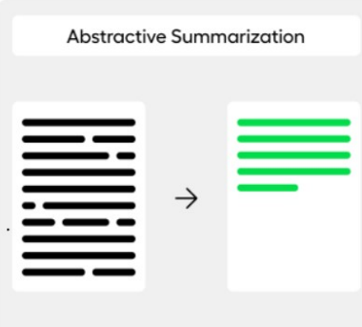
How abstractive summarization works: generating new sentences
Abstractive summarization mainly focuses on generating a summary using new sentences that capture the essence of the original text, rather than just selecting existing sentences
.

Slide 12
Techniques involved (e.g., sequence-to-sequence models, pre-trained models)
Sequence-to-Sequence Models: These models map an input text sequence (document ) to an output sequence (summary ), e.g., LSTM-based Seq2Seq or RNN-based Seq2Seq.
Pre-trained Language Models: Large language models such as PEGASUS, T5, BART, GPT which are
fine-tuned for summarization tasks using large datasets.
PEGASUS is a Transformer-based model designed specifically for text summarization. Unlike other models, PEGASUS uses a unique pre-training strategy where critical sentences are masked during training. The model is then tasked with generating these hidden sentences, which enables it to create more accurate and coherent summaries.

Slide 13
Benefits and challenges of abstractive summarization
Abstractive methods produce more natural and readable summaries, enhancing user experience. They can synthesize and condense information creatively. However, they require large datasets, significant computing power, and may occasionally generate inaccuracies or hallucinations, posing challenges in reliability and precision.

Slide 14
04
Comparison and Applications

Slide 15
Extractive v/s Abstractive Summarization
Feature | Extractive Summarization | Abstractive Summarization
How it works | Selects key sentences or phrases directly from the original text | Generates new sentences that capture the main ideas
Output style | Uses exact words from the source | Uses paraphrased or rephrased text
Analogy | Like highlighting important lines in a book | Like explaining the book in your own words
Cohesion | May feel choppy or disjointed | More fluent and natural
Complexity | Simpler; rule- or score-based | Harder; requires NLP and language generation models
Example | Original text: “AI is transforming industries by automating tasks.”→ Extractive: “AI is transforming industries.” | Abstractive: “Artificial intelligence is changing many fields through automation.”

Slide 16
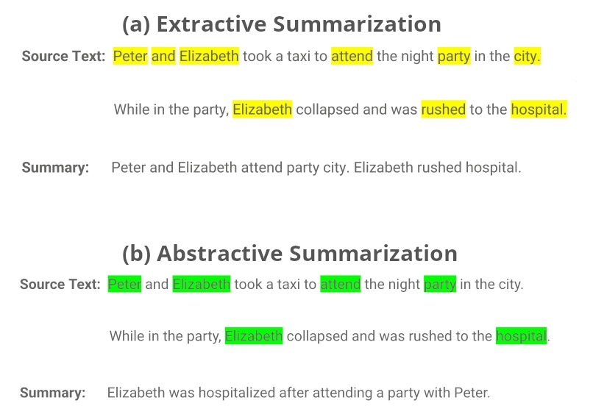
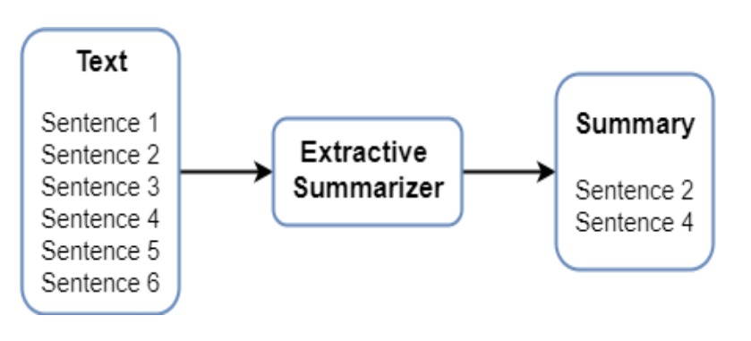
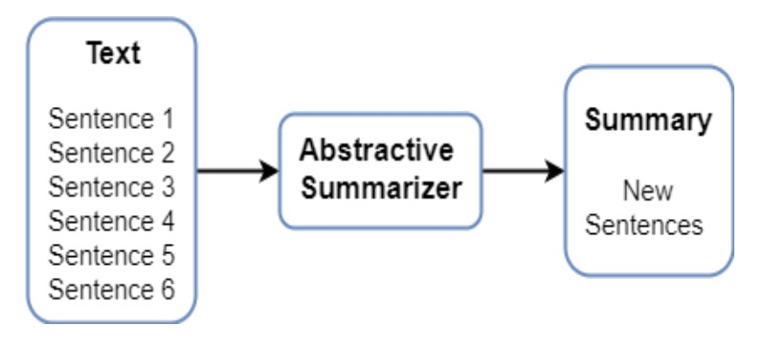

Slide 17
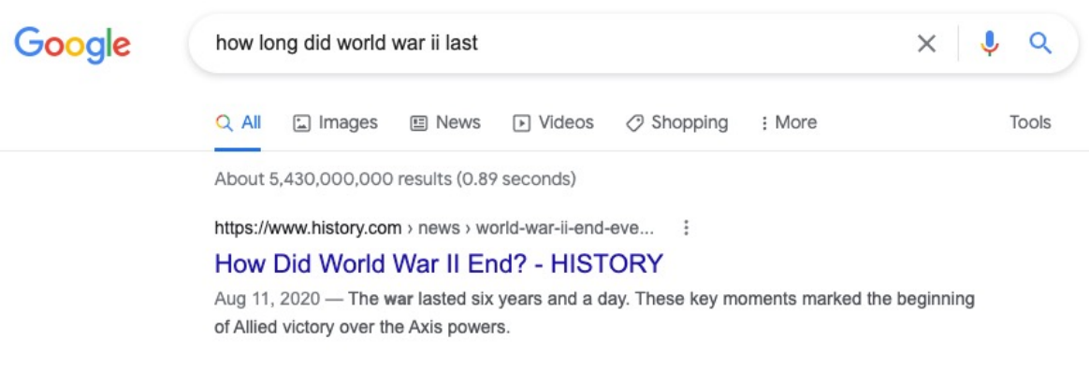
Applications of Summarization in Real Life
News Summarization: Generate short versions of news articles or headlines.
Legal & Research Docs: Summarize long case
laws, research papers, or contracts.
Customer Support: Summarize chat logs,
complaint tickets, and call transcripts.
Medical Field: Condense patient records and
clinical trial reports.
Social Media & Reviews: Summarize tweets, comments, or product reviews.
Search Engines: Provide quick snippets or previews of web pages. (Google search)
Education: Summarize lectures, notes, or study materials automatically.

Slide 18

Conclusions
Text summarization is essential for managing information effectively.
Extractive and abstractive techniques each offer unique strengths and challenges.
Understanding their differences enables informed method selection tailored to specific needs, while ongoing research promises enhanced, more intelligent summarization solutions for the future.

Slide 19
THANK YOU!
Dheeraj Banavath | 2301AI08
Sathvik Marella | 2301AI34
Dundi Kuladeepeswar | 2301AI09
Pitta Tanuj | 2301AI29

